Slide 1
Study of Breast Cancer
Our team sought to review what the most important patient features are in determining successful breast cancer treatment, and then to create a model to assist with the prediction of treatment success.
Nick Prieto, Zibo Zhao, Helena Zhang, Eugene Kikuchi, Priscilla Robinson
Dec 11, 2021

Slide 2
background
Breast cancer
Most frequent cancer among women
The greatest number of cancer-related deaths among women
Clinical decision-making in patients with cancers
Accurate estimation of prognosis and survival duration/outcome
Machine learning techniques on clinical and gene expression data
Dataset
1904 breast cancer patients
30 clinical attributes (not include patient id)
m-RNA levels z-score for 489 genes
mutation in 173 genes
Data Source:
https://www.kaggle.com/raghadalharbi/breast-cancer-gene-expression-profiles-metabric
Reference: https://www.nature.com/articles/s41523-018-0056-8 https://www.ncbi.nlm.nih.gov/pmc/articles/PMC5461908/ https://www.cbioportal.org/study/summary?id=brca_metabric

Slide 3
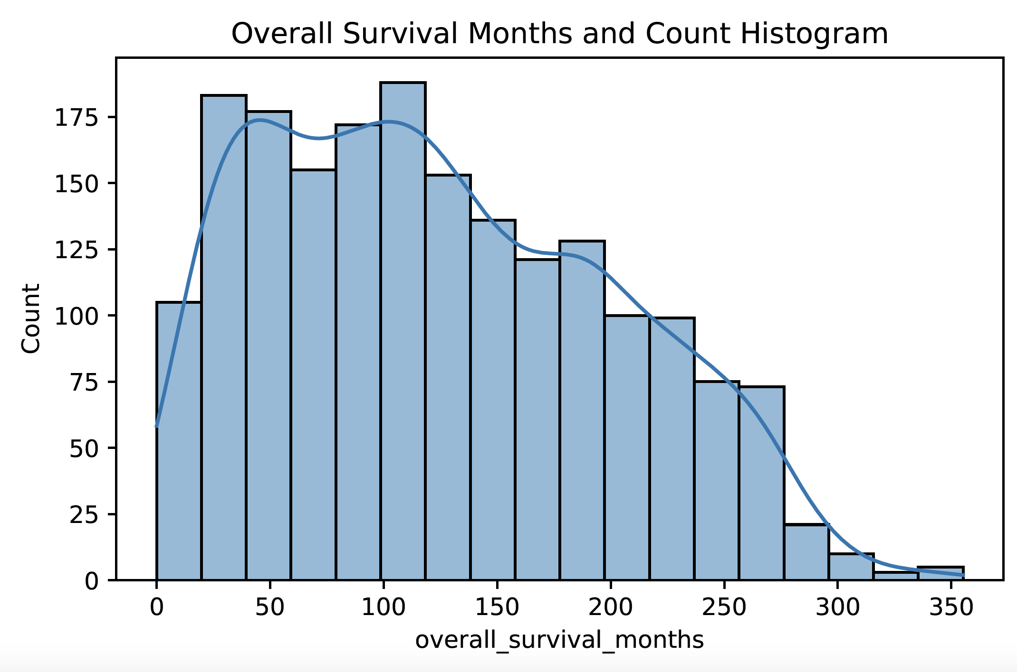
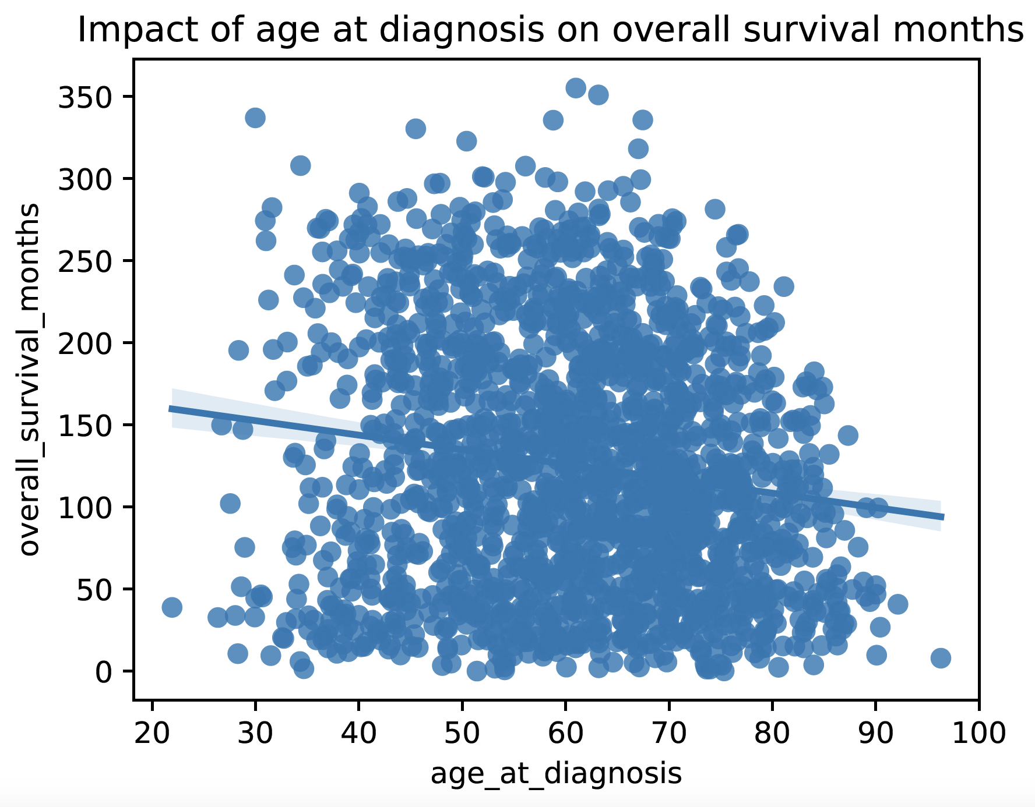
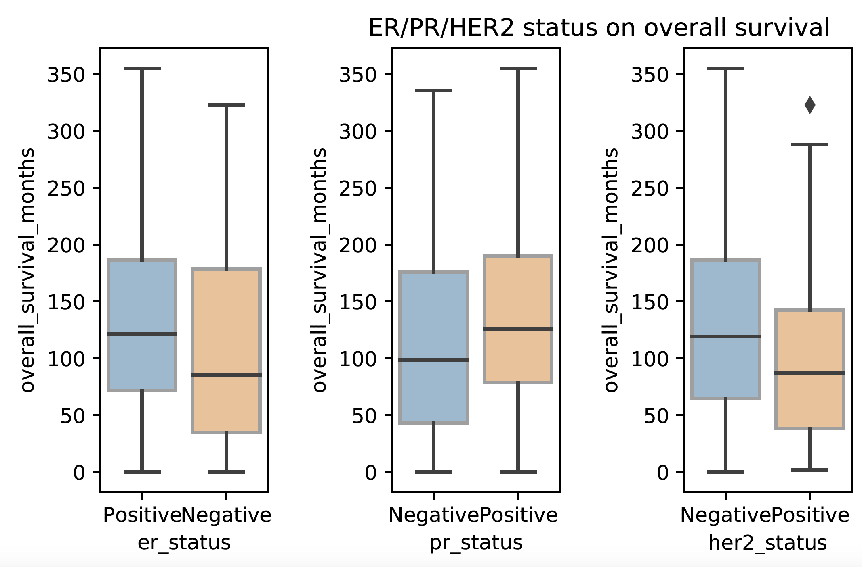
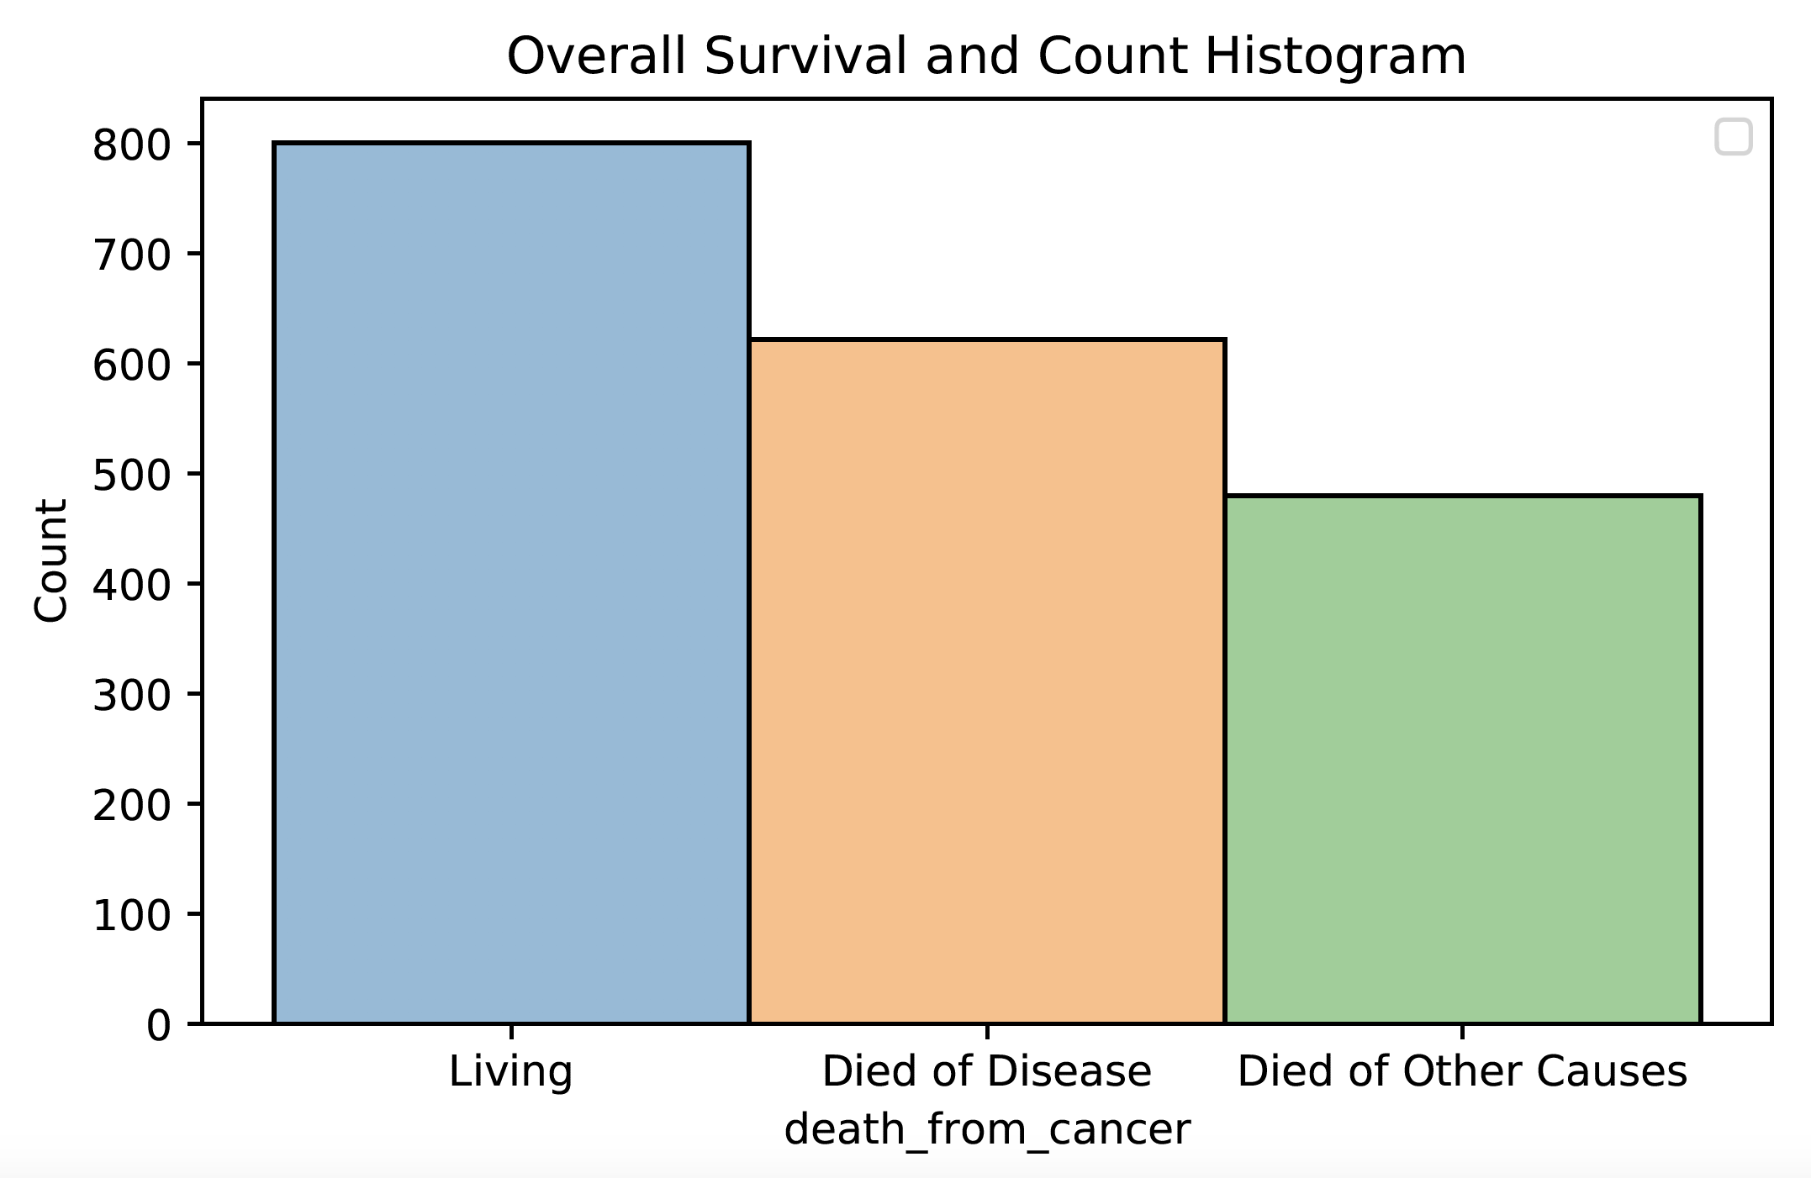
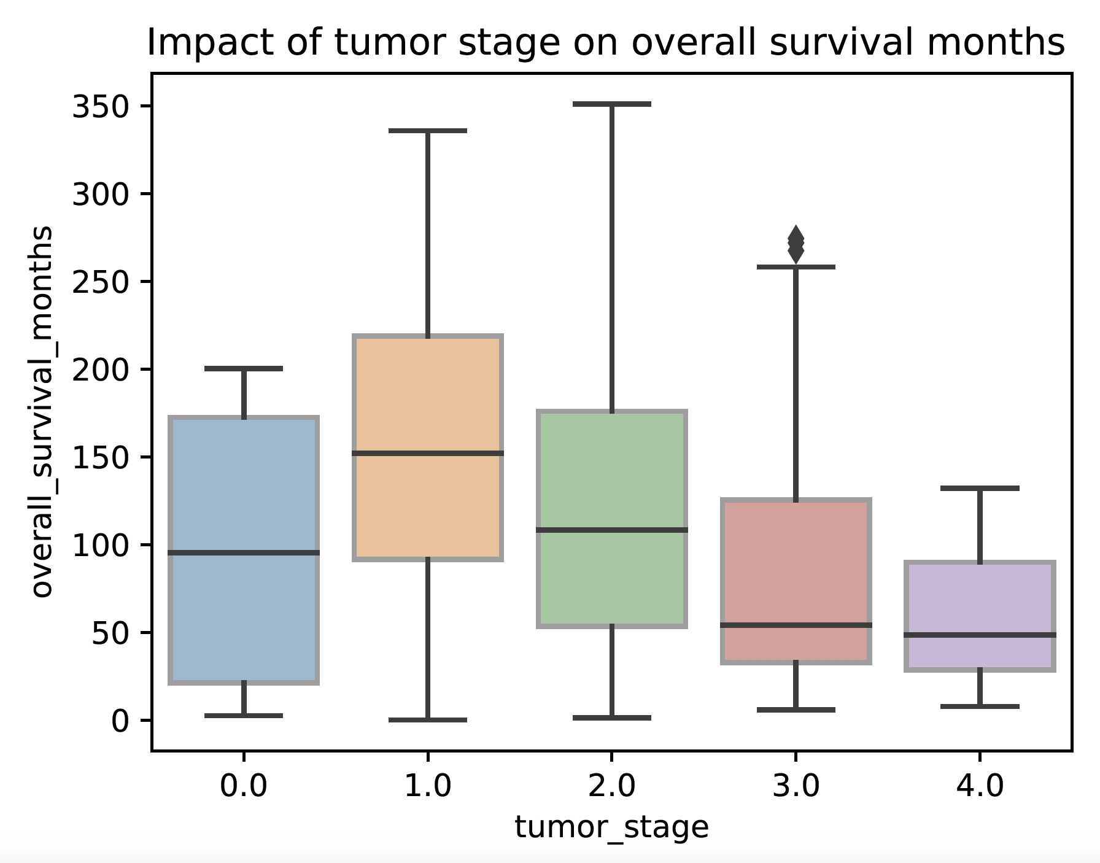
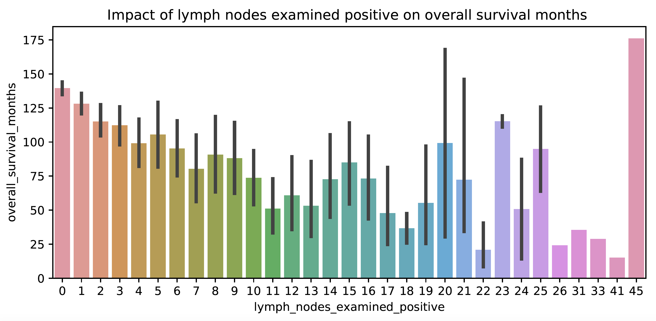
Correlation analysis and feature selection
Step1:
Target Distribution
Step II:
Correlation Analyses

Slide 4
Correlation analysis and feature selection
Step III:
Feature Selection
Target (2):
overall_survival
overall_survival_months
Features (19):
age_at_diagnosis
chemotherapy
neoplasm_histologic_grade
hormone_therapy
lymph_nodes_examined_positive
mutation_count
radio_therapy
tumor_size
tumor_stage encoded_type_of_breast_surgery
encoded_cancer_type_detailed encoded_cellularity
encoded_pam50_+_claudin-low_subtype
encoded_er_status
encoded_her2_status
encoded_tumor_other_histologic_subtype
encoded_inferred_menopausal_state
encoded_integrative_cluster
encoded_pr_status

Slide 5
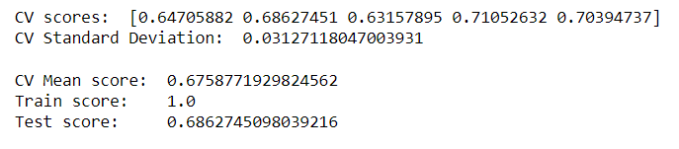
Supervised machine learning
Supervised Machine Learning Models for Prediction of Breast Cancer Survival
We utilized 30 clinical attributes in our 5 different models (Logistic Regression, SVC, Random Forest Classifier, AdaBoost, and XGBoost)
Our Random Forest Classifier produced the Strongest Accuracy at 0.686

Slide 6
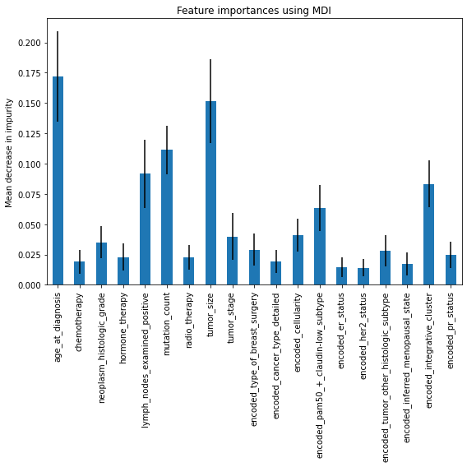
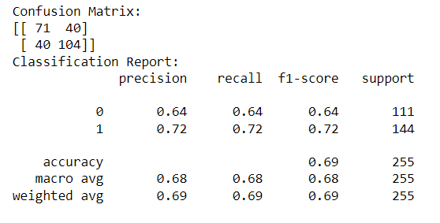
Random Forest Classifier

Slide 7
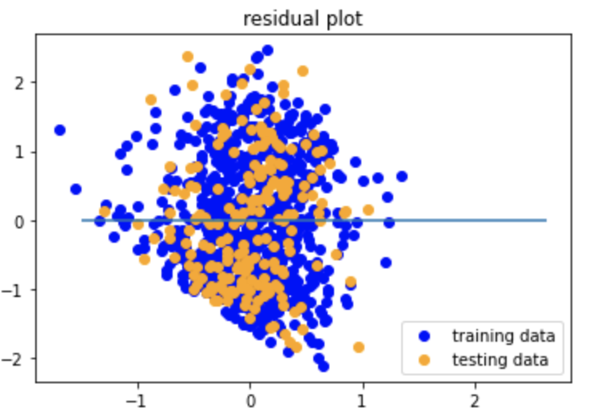
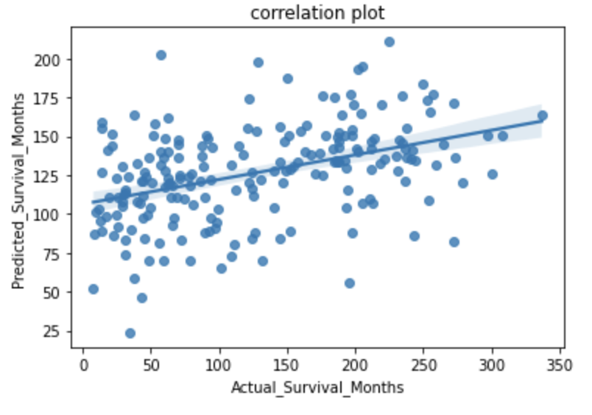
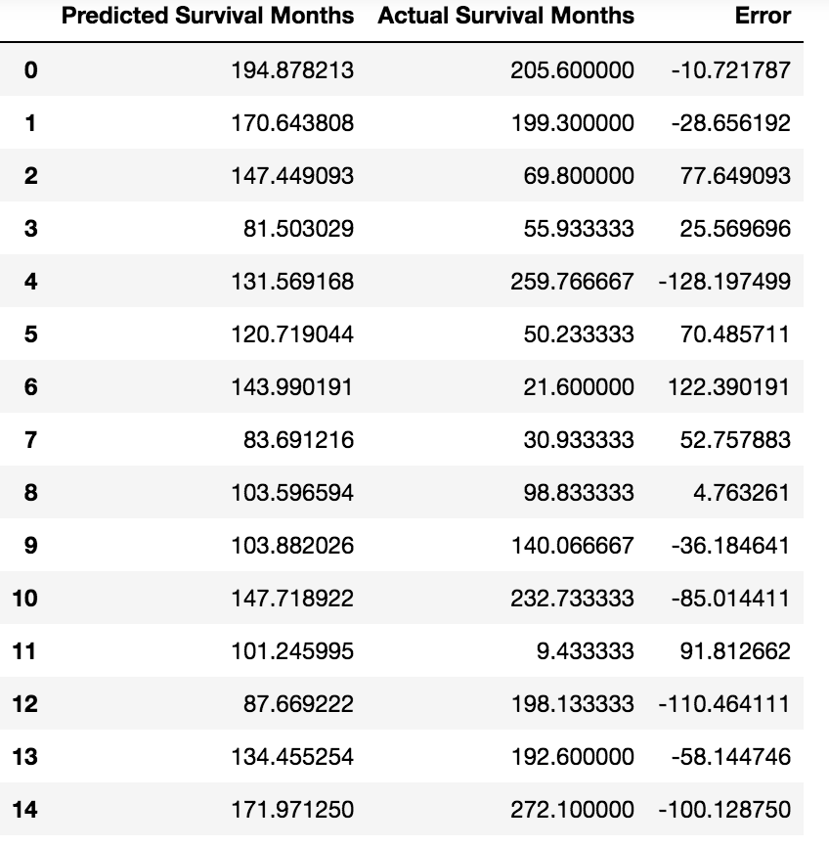
Supervised machine learning
Prediction of Breast Cancer Survival Months- Multiple linear regression
- Testing Score: 0.1693
- MSE: 0.847
- R2: 0.169
Multiple Linear Regression prediction on the survival time is weak, with high error.
However, the following features are the top 5 most important for predicting the survival outcome (based on the absolute values of the coefficients) :
- age_at_diagnosis
- encoded_tumor_other_histologic_subtype
- tumor_stage
- lymph_nodes_examined_positive
- encoded_cancer_type_detailed

Slide 8
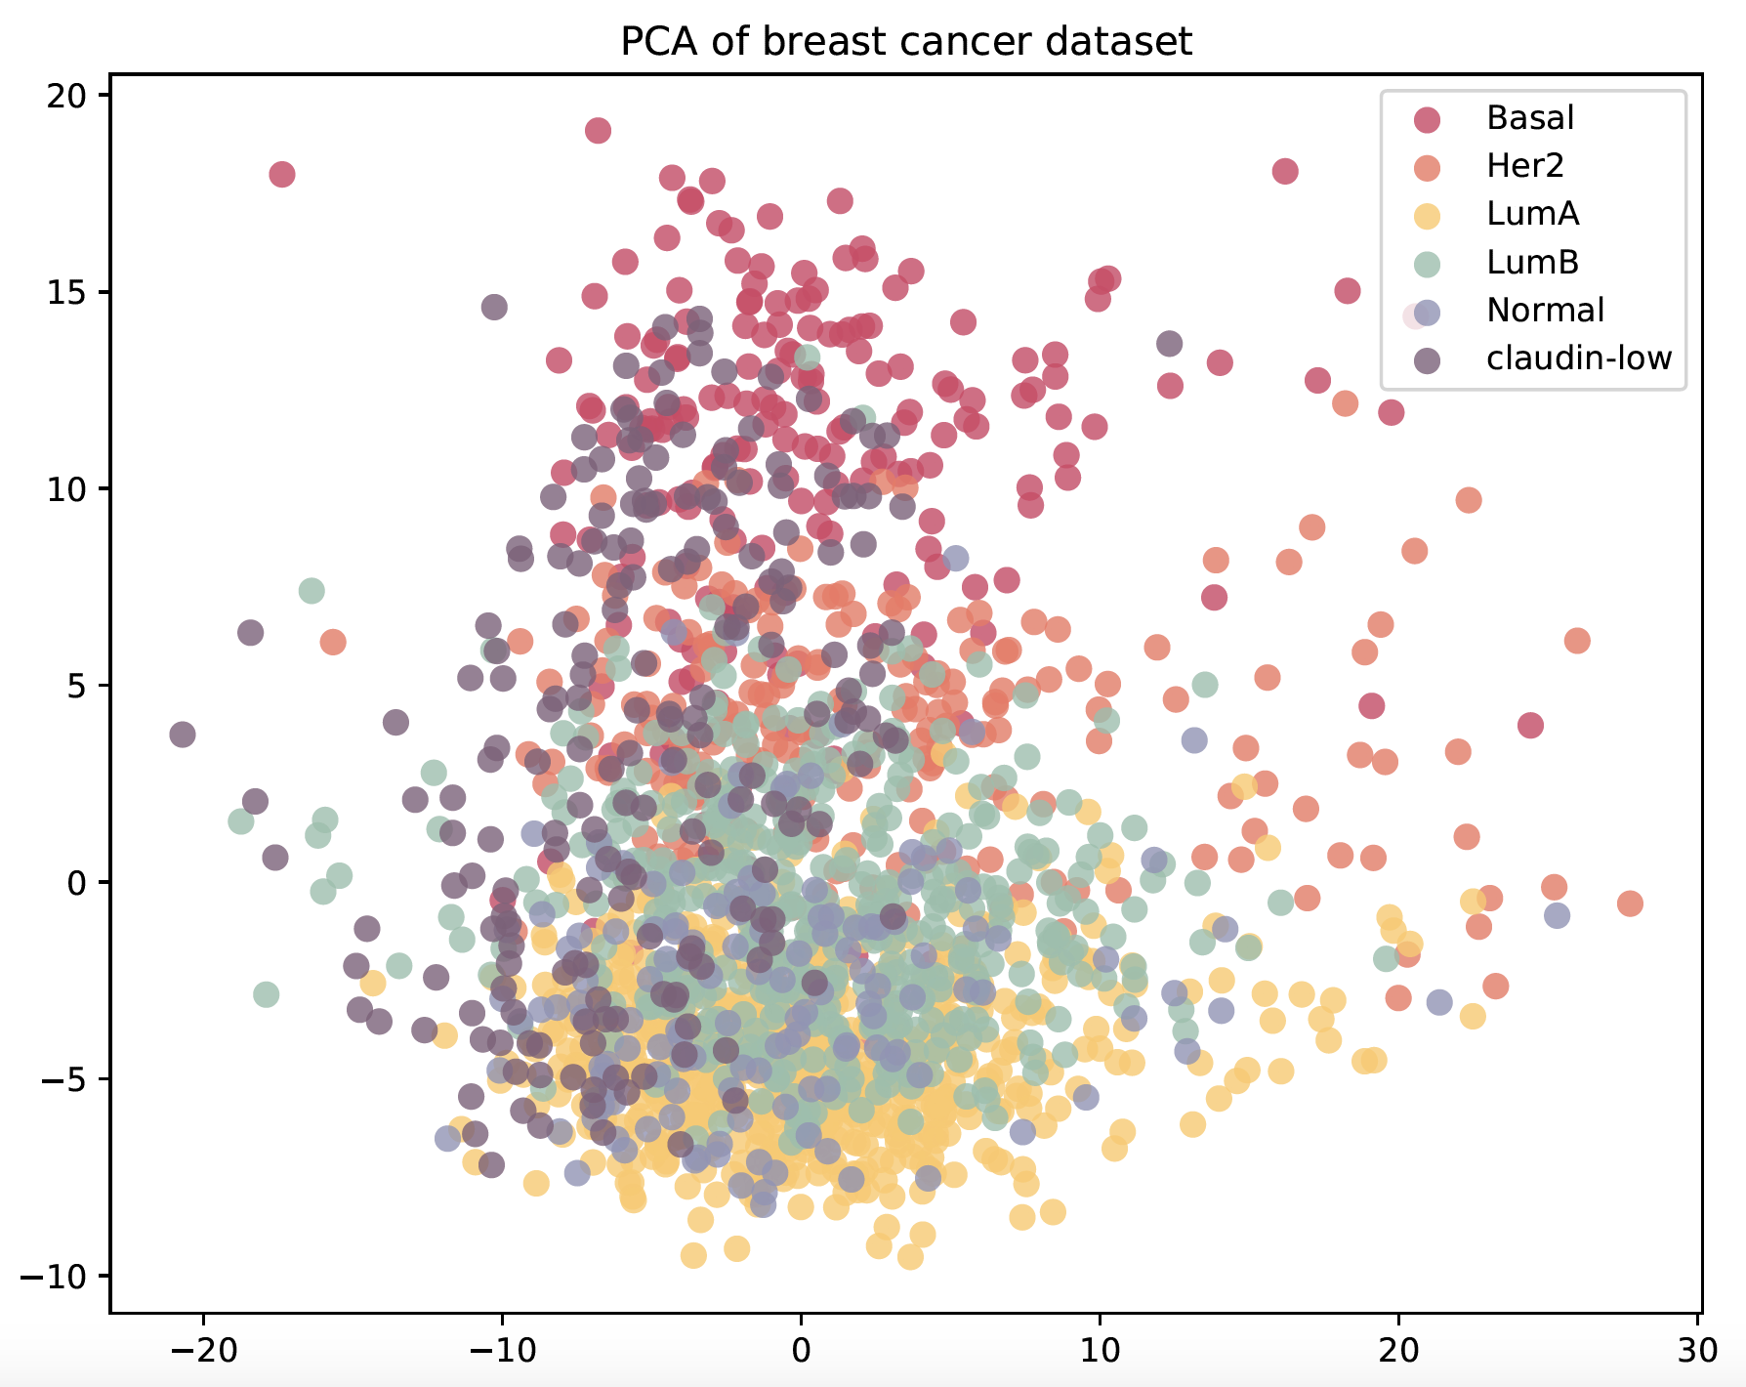
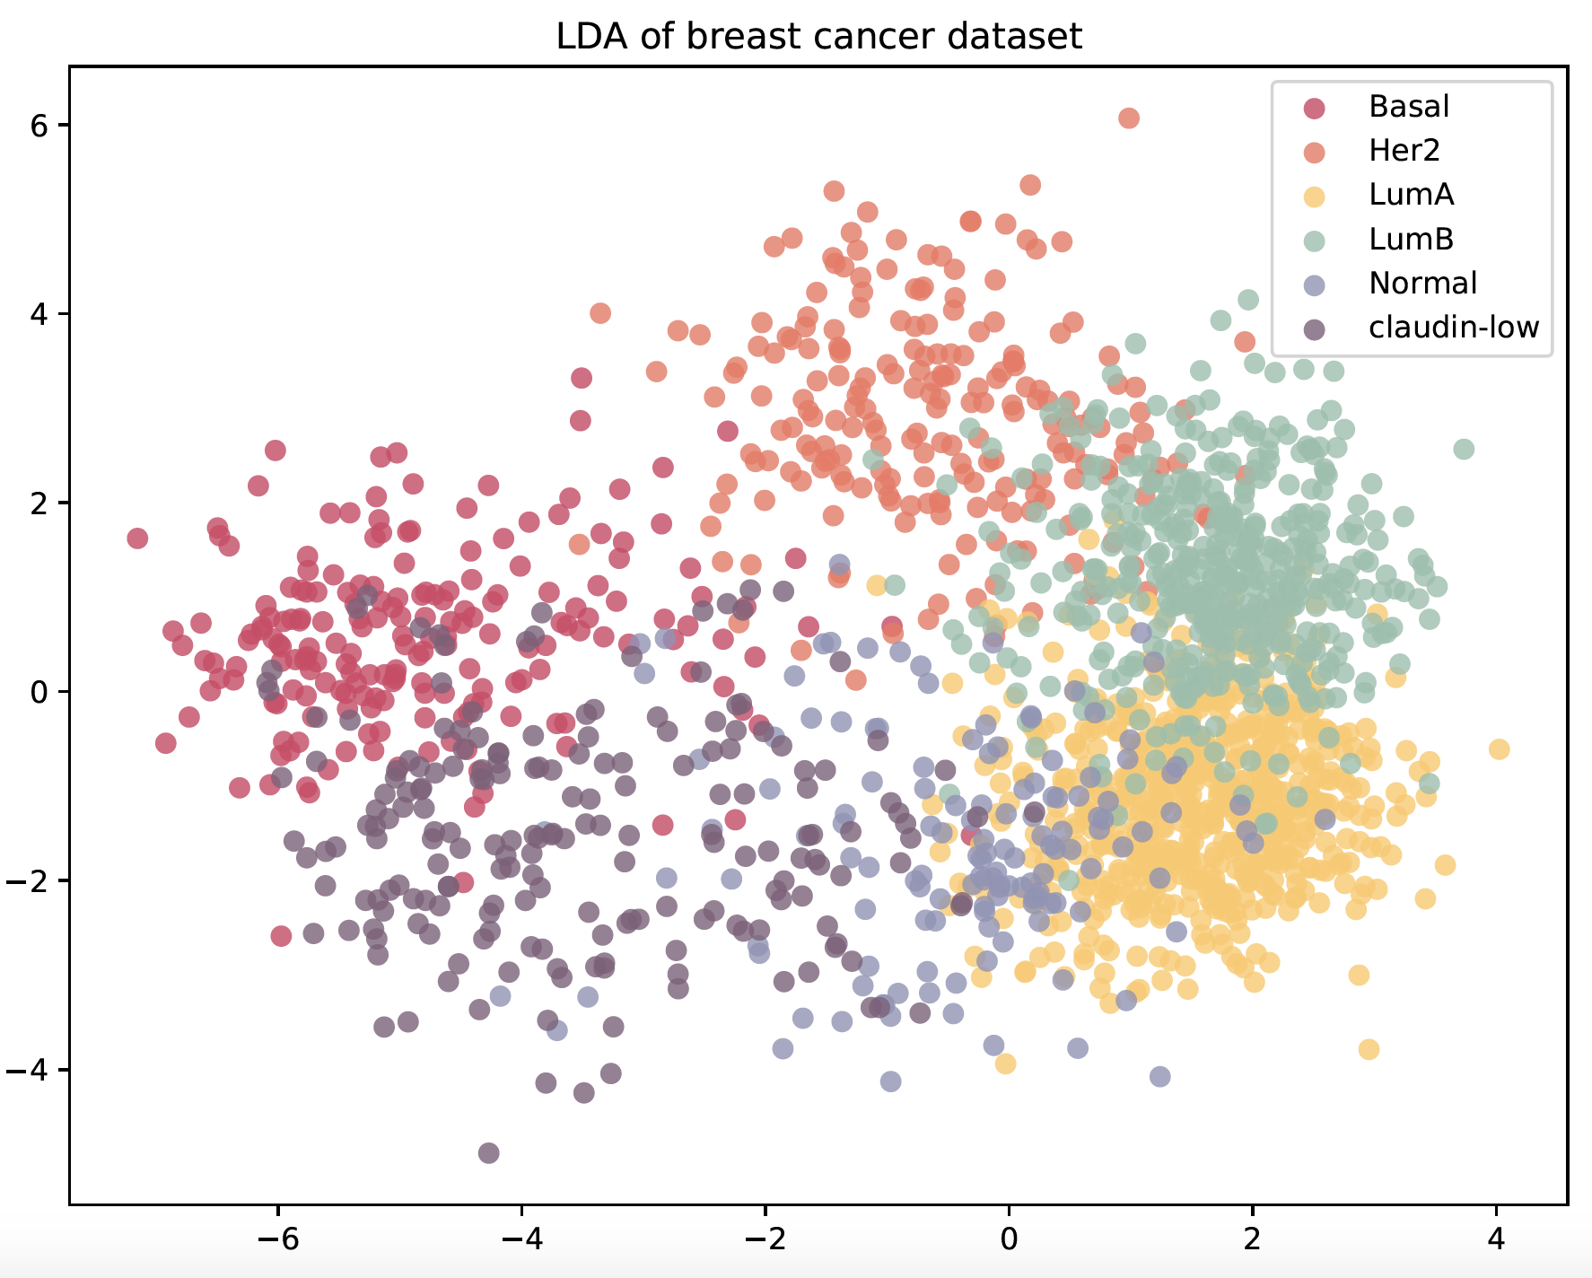
Unsupervised machine learning 1
- PCA and LDA
Principal Component Analysis (PCA)
Identify the combination of attributes that account for the most variance in the data.
Explained variance ratio (first two components): [0.07960216 0.06701992]
Linear Discriminant Analysis (LDA)
Identify attributes that account for the most variance between classes.
A supervised method, using known class labels.

Slide 9
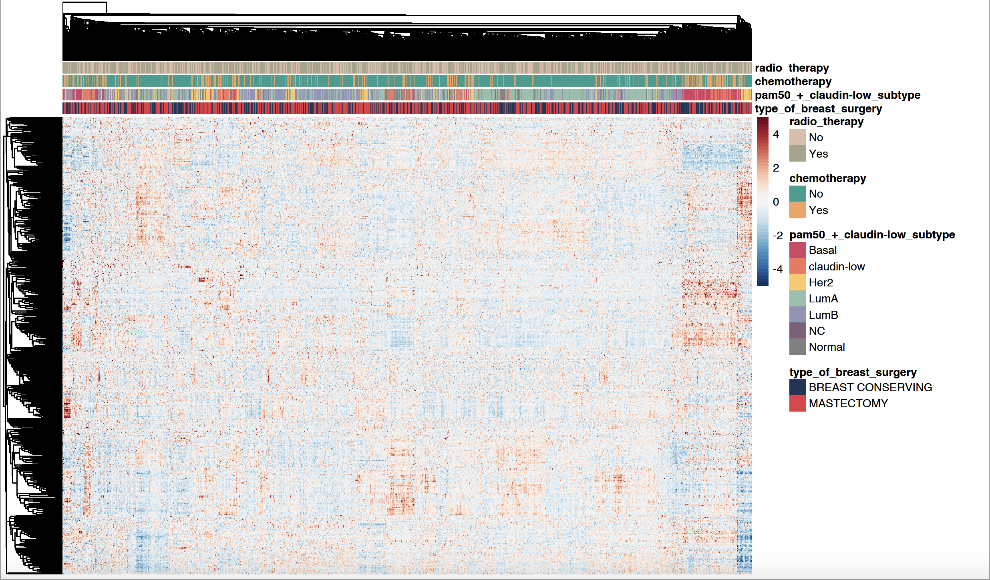
Unsupervised machine learning II
- Hierarchical clustering
R
library(tidyverse)
library(pheatmap)
library(RColorBrewer)
clustering_distance_rows = "correlation",
clustering_method = "average”
Row (489):
Gene expression z-score
Column (1904):
Patient sample

Slide 10





INFRASTRUCTURE
Heroku hosted
Backend
PostgreSQL Database
Flask API
Frontend
Home Page
Outcome Prediction Page

Slide 11





OUTCOME PREDICTION

Slide 12
WEBPAGE
Live Demo!

